Slide 1
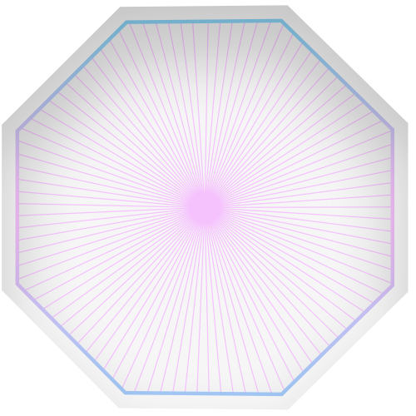
Disney Animated Character Recognition
Group 9: Kaitlyn Le, Anh Tran, Benjamin Tutka

Slide 2
01
Problem Statement

Slide 3
Problem Statement
Our goal is to build a model that recognizes Disney animated characters from various movie scenes.

Slide 4
Why It’s Interesting
Technological advancements → advancements in animation & media/entertainment industry
New consumer experiences
Enables new applications for illustrators/writers
Hypothetically could be used to develop a more enhanced recommendation system and/or cater towards more personalized experiences
Art style
Favorite characters
Marketing: identify which characters are popular across various platforms

Slide 5

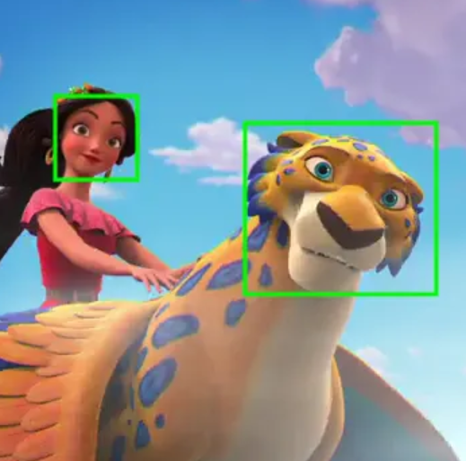
Previous Approaches
Disney’s Direct-to-Consumer & International Organization (DTCI) Technology
Used traditional ML methods like HOG+SVM
Histogram of Oriented Gradients
Support Vector Machine
Developed first automated pipeline
Provided framework for facial detection and recognition model
Worked particularly well for live-action characters but struggled to recognize animated characters that didn’t have normal human features/proportions

Slide 6
02
Data

Slide 7
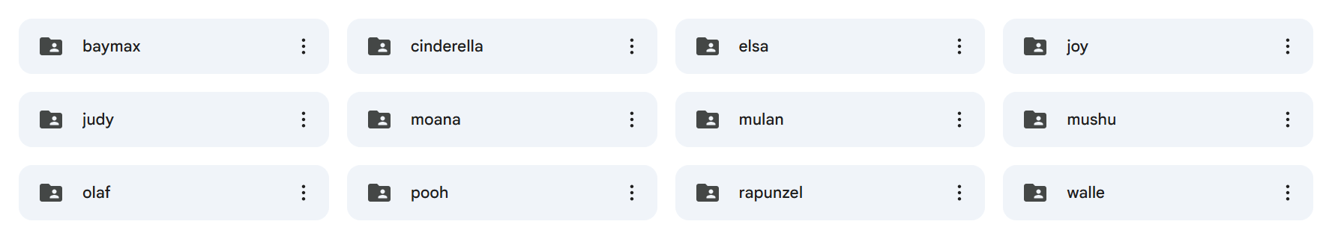
The Data
Each team member gathered around 25-27 images for four different characters
Each character’s images were placed in own folder
Dataset: 310 images in total
Images were snapshots from various movie scenes
Only one character in frame
Character’s face must be visible

Slide 8



Data Preprocessing
Format
Labels
Size
All image types were converted to PNG files (if they weren’t already)
Standardized labels with format “charactername1.png”, “charactername2.png”, etc.
Resized to the same size of 28x28 pixels, maintaining aspect ratio (padding added where necessary)

Slide 9
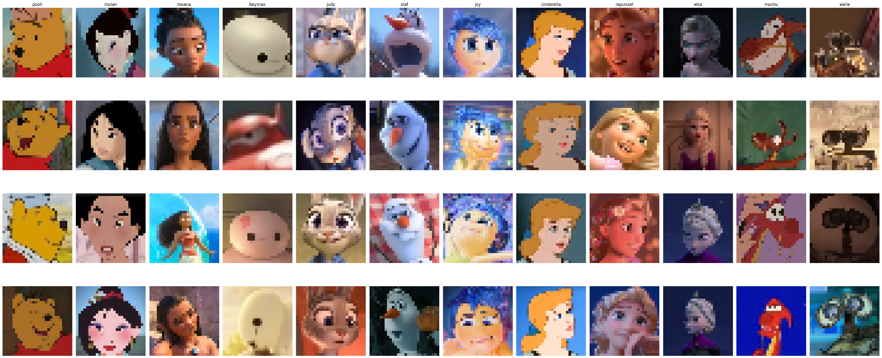
Example

Slide 10
03
Machine Learning Model

Slide 11
The Models
Simple CNN
(Traditional ConvNet)
Siamese CNN
Uses layers to detect features, recognize patterns, and make predictions
Serves as a good baseline for image processing
Learns to measure similarity between pairs of images rather than predicting a class label
Outputs a similarity score of whether two images belong to the same character or not
Allows model to generalize well with limited data

Slide 12
Evaluation Metrics
Accuracy
Precision
Overall assessment of how well model performs across all classes; proportion of correct predictions (TP & TN)
Measures how many positive predictions made by the model are actually correct
Recall
Measures model’s ability to correctly identify all positive instances

Slide 13
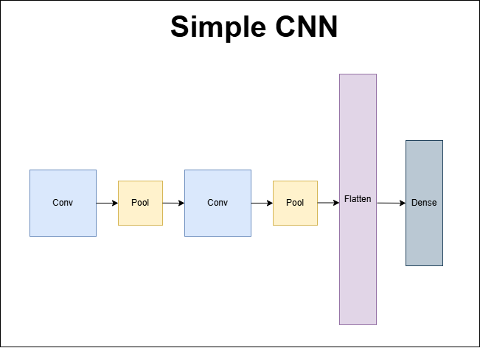

Slide 14
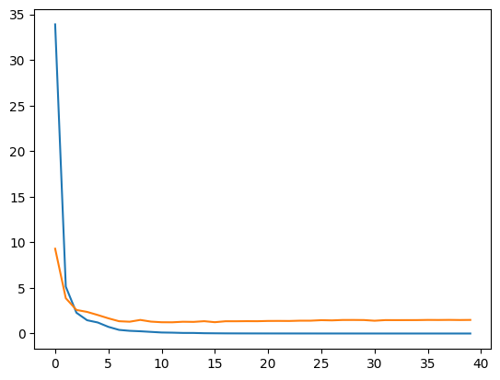
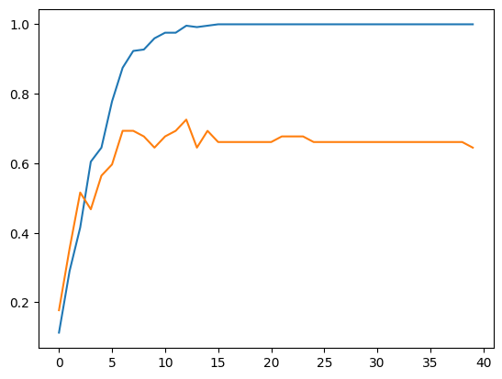
Simple CNN Training
Batch size : 32
Used Adam optimizer
Used Sparse Categorical Cross Entropy
Epoch of 40
Blue: Train
Orange: Val

Slide 15
Simple CNN Results
Classification Score
Test:
Accuracy: 0.65
Precision: 0.70
Recall: 0.65
Train:
Accuracy: 0.99
Precision: 0.99
Recall: 0.99

Slide 16
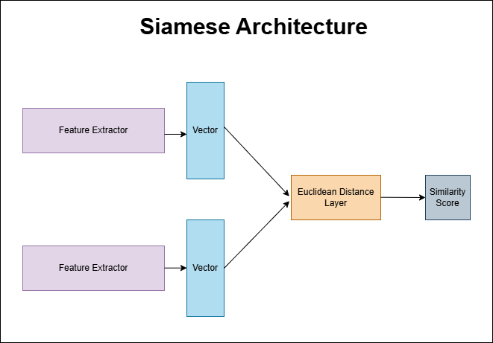

Slide 17
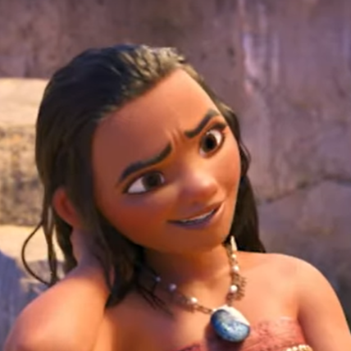
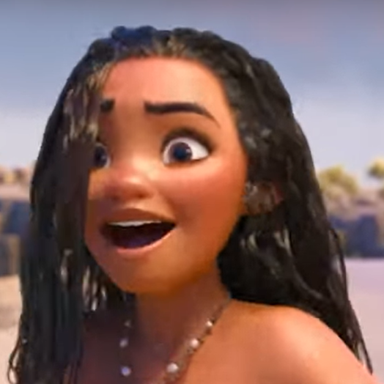
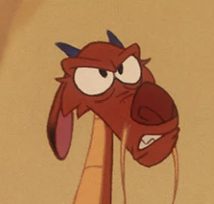
Siamese Data Inputs
The Siamese CNN model requires two input images. We created image pairs, labeling them as 1 if they belong to the same class and 0 if they do not
Label = 1
Label = 0

Slide 18
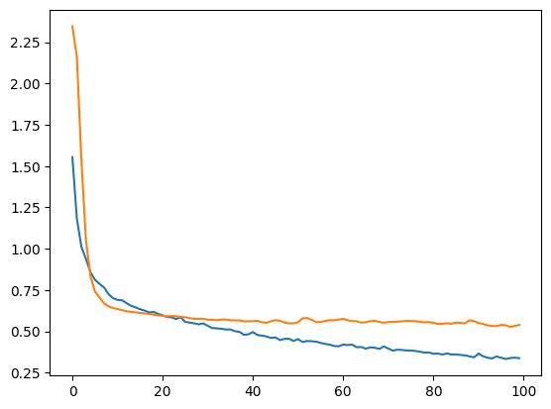
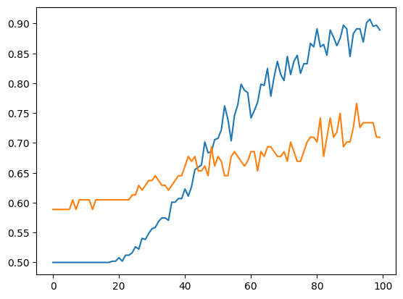
Siamese Training
Batch size : 64
Used Adam optimizer
Used Binary Cross Entropy for Loss Function
Epoch of 100
Although our Siamese Model did converge, there is a clear presence of overfitting
Blue: Train
Orange: Val

Slide 19
Siamese CNN for Classification
Our Siamese CNN outputs similarity scores. To use this as a classification tool, we followed these steps:
Created a reference image batch containing one representative image per class
For each test image, computed similarity scores against each reference image, generating an array of 12 scores (one per class)
Selected the class with the highest similarity score as the predicted label

Slide 20
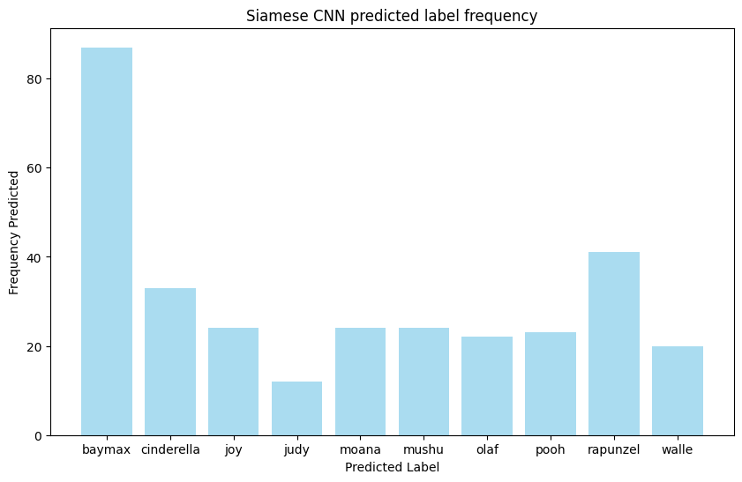

Slide 21
Siamese Results
Similarity Scores
Classification
Test:
Accuracy: 0.68
Precision: 0.71
Recall: 0.67
Train:
Accuracy: 0.86
Precision: 0.86
Recall: 0.85
Accuracy: 0.61
Precision: 0.58
Recall: 0.62

Slide 22
Key Takeaways
The traditional CNN and Siamese CNN performed about the same for classifying images
Traditional CNN performed slightly better than Siamese
Siamese CNNs are better suited for similarity tasks rather than direct classification
The reason for lower performance in our model may be due to the fact that it couldn’t capture fine-grained details needed for differentiating similar character classes
Data preparation is very crucial
Image sizes need to be standardized and inputs formatted correctly to ensure the models function as intended
Establishing a baseline with traditional models is important for evaluating the effectiveness of more complex architectures (e.g., Siamese networks) in classification tasks

Slide 23
Next Steps
Implement data augmentation techniques to create a more robust dataset
Evaluate the Siamese model on unseen data
While traditional CNN tend to force classification for any input, the Siamese CNN can potentially provide a low similarity score for unknown characters, allowing us to identify images that do not belong to any of the known classes in our reference database

Slide 24
Thank you!

